Slide 1
El lenguaje, el tiempo y la inmortalidad en los cuentos de Jorge Luis Borges
The Concept of Language, Time and Immortality the Short Stories of Jorge Luis Borges

Slide 2
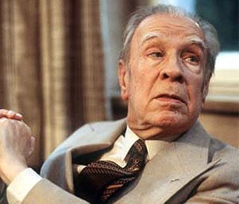
Jorge Luis Borges was a man of wisdom!
Jorge Luis Borges was born in Argentina in 1899 and died in Switzerland in 1986.
Jorge Luis Borges was one the most influential intellectuals in the academic world.
Borges had an infinite knowledge about a variety of different kinds of literature ( English Literature, German Literature, Spanish Literature, Asian Literature.)

Slide 3
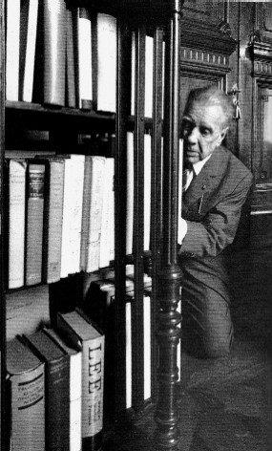
Borges and his addiction to literature
Jorge Luis Borges has been categorized as the “One who knew it all and invented it all!”
Borges uses his infinite universal literature knowledge on every single literary creation
Philosophical and metaphysical concepts were his obsessions!!
The complex concepts of TIME, LANGUAGE AND INMORTALITY are, undoubtedly, the purpose of his prominent work.

Slide 4
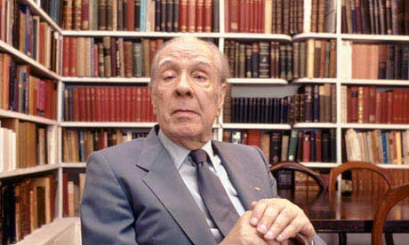
BORGES DOES NOT CATEGORIZE HIMSELF AS A PHILOSPHER
Borges is viewed by many important thinkers as a philosopher:
“His contributions to the philosophical world are indeed valuable…”
*However, Borges identify himself as a curious writer who thinks critically the most complex questions:
“I never try to find the answer to a problem which we know the answer is inferior the question itself…”
By portraying the metaphysical and philosophical questions of TIME, INMORTALITY AND LANGUAGE, Borges is indeed contributing to ask the question many have forgotten about.
“Yo soy un Lector, simplemente. A mi no se me ha ocurrido nada. Se me han ocurrido fabulas con temas filosoficos, pero no ideas filosoficas…” (J.L.B)

Slide 5
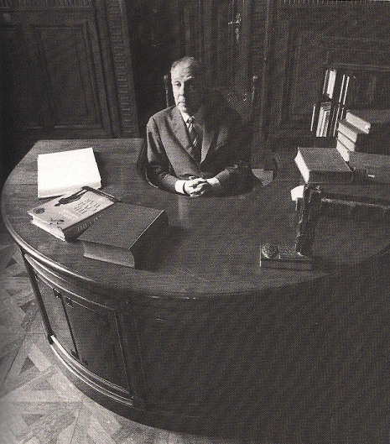
BORGES WAS INFLUENCED BY GERMAN PHILOSOPHERS LIKE FRITZ MAUTHNER
Borges had read over and over again the philosophical texts of Mauthner.
Per Borges own interpretation of Mauthner, the philosophical texts created by such notorious philosopher show an absolute idea that language only works to hide reality or to express in a esthetical way.
LANGUAGE is the last and most profound problem of the philosophical mind :
“Philosophie ist kritische Aufmerksamkeit auf die Sprache”

Slide 6
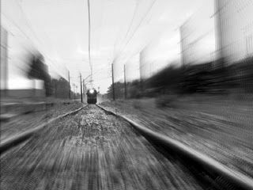
El sur: a short story where the concept of time is undoubtedly EXPOSED

Slide 7
El ALEPH: a short story where the concept of time is undoubtedly EXPOSED

Slide 8
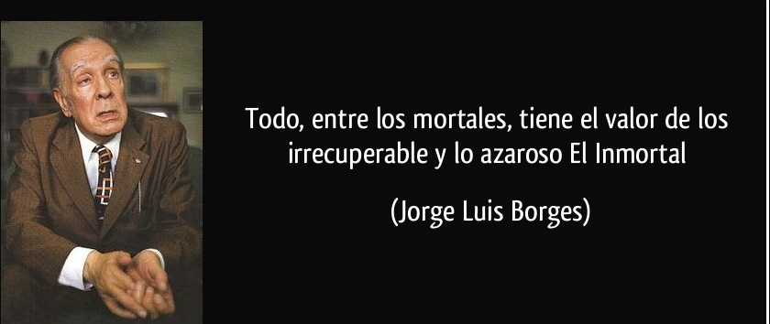
El INMORTAL: a short story where the concept of INMORTALITY AND TIME is undoubtedly EXPOSED

Slide 9
LITERATURE IS THE ONLY WAY TO MANIPULATE TIME TO BECOME INMORTAL BY EXPANDING LANGUAGE TO THE FULLEST

Slide 10
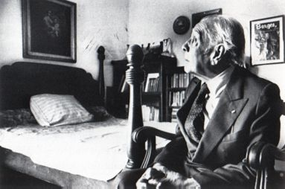
JORGE LUIS BORGES LIVES WITHIN US, LIVES IN US AS WE READ HIS WORK: only the greatest become inmortal with literature

Slide 11
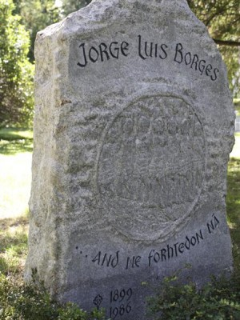
JORGE LUIS BORGES WAS A GREAT MAN, HIS INFINITE WISDOM OF LITERATURE CREATED A NEW KIND OF LITERARE KNOWN AS “LITERATURE BORGEANA”
Borges lives on us
Borges is one the greatest writer of all time.
Everyone has either read of heard of Borges
Borges is Inmortal

Slide 12
THANK YOU!!
Jose Roque Alfaro

